Slide 1
E-LEARNING SYSTEM
SANTHIYA CK
23CSEA27
II-MCA
bATCH-i

Slide 2
AGENTA
Introduction
Objective
Problem Statement
Existing System
Proposed System
Technology Stack
Modules
Flowchart
Features
Conclusion

Slide 3
INTRODUCTION
The E-learning Platform is a web-based system developed using PHP and MySQL to provide a structured and interactive online learning environment.
It offers features like secure user authentication, course management, quizzes, certifications, and live classes. The platform supports multimedia content for better engagement and ensures efficient content management through an admin panel.
Its scalable database architecture and modular design enable easy maintenance and future upgrades.
The system addresses accessibility challenges and aims to enhance learning with future features like AI-based recommendations and automated grading.

Slide 4
OBJECTIVES
The main objective of the E-learning Platform is to develop an interactive and efficient web-based system for online education.
It enables educators to create, manage, and distribute courses easily while providing learners with a user-friendly platform to enroll and complete courses.
The system integrates quizzes for assessment and supports multimedia content for an enhanced learning experience. It ensures scalability and data integrity through a database-driven structure.
Overall, it aims to overcome traditional learning limitations and provide a flexible digital learning environment.

Slide 5
PROBLEM STATEMENT
In the modern education system, students and instructors face several challenges like limited access to study materials, lack of flexibility in learning schedules, and inefficient course management.
Traditional learning methods do not support remote access and personalized learning experiences.
Manual handling of quizzes, student performance tracking, and content management consumes a lot of time and effort.
This system should provide students with easy access to courses, study materials, quizzes, and certifications from any location. There is a need for a secure, user-friendly, and automated E-Learning Management System.

Slide 6
EXISTING SYSTEM
Traditional learning systems mainly depend on physical classrooms, printed materials, and offline assessments, which limit accessibility and flexibility for learners.
Existing online platforms lack interactive features like live classes, quizzes, and real-time engagement tools.
Manual evaluation methods increase the workload for educators, while course management remains unstructured and inefficient.
Additionally, limited access to study materials and poor content distribution further affect the learning process. Security concerns also arise due to weak authentication systems, making user data vulnerable to threats.

Slide 7
PROPOSED SYSTEM
The proposed E-learning System is a web-based system that enhances online education by providing secure user authentication, interactive learning modules, and automated assessments.
It offers anytime access to courses, quizzes, and resources while promoting engagement through multimedia content and live classes.
The platform allows instructors to manage courses efficiently and provides real-time progress tracking for students.
With role-based access control and secure login mechanisms, the system ensures data safety and user privacy.
Its scalable and flexible architecture supports easy expansion and integration of new features for future enhancements.

Slide 8
TECHNOLOGY STACK
FRONTEND TECHNOLOGIES:
HTML5
CSS3
JavaScript
Bootstrap
BACKEND TECHNOLOGIES:
PHP
DATABASE:
MySQL
SERVER:
XAMPP Server

Slide 9
MODULES
USER AUTHENTICATION MODULE
The User Authentication Module plays a crucial role in managing user registration, login, and logout processes securely. It ensures that only authorized users can access the platform by implementing role-based access control for students, instructors, and administrators. Passwords are encrypted to protect sensitive information, and validation checks are performed to prevent unauthorized access.
MULTIMEDIA CONTENT MANAGEMENT
The Multimedia Content Management Module enables instructors to upload and manage various learning materials such as videos, PDFs, and interactive content. This module ensures that the learning resources are easily accessible, well-organized, and delivered smoothly to provide an enhanced learning experience for students.

Slide 10
MODULES
QUIZ AND ASSESSMENT MODULE
The Quiz and Assessment Module allows educators to create online quizzes and assessments for evaluating student performance. This module supports automated grading systems that provide instant feedback to students after quiz completion. The performance results are stored in the database for future tracking and analysis.
ADMIN PANEL MODULE
The Admin Panel Module provides administrators with full control over managing the platform, including handling user accounts, monitoring course content, and managing system settings. This module offers analytics and insights on user activity, ensuring secure content moderation, role management, and performance monitoring.

Slide 11
MODULES
DASHBOARD MODULE
The Dashboard Module serves as an interactive interface for students and instructors, providing an overview of student progress, enrolled courses, quizzes, and certifications. It offers easy navigation to different features and ensures a user-friendly experience.
DATABASE MANAGEMENT MODULE
The Database Management Module handles the storage, retrieval, and maintenance of all data within the system. It manages user profiles, course enrollments, quiz results, and certifications while ensuring data integrity, security, and efficient query processing for a seamless user experience.

Slide 12
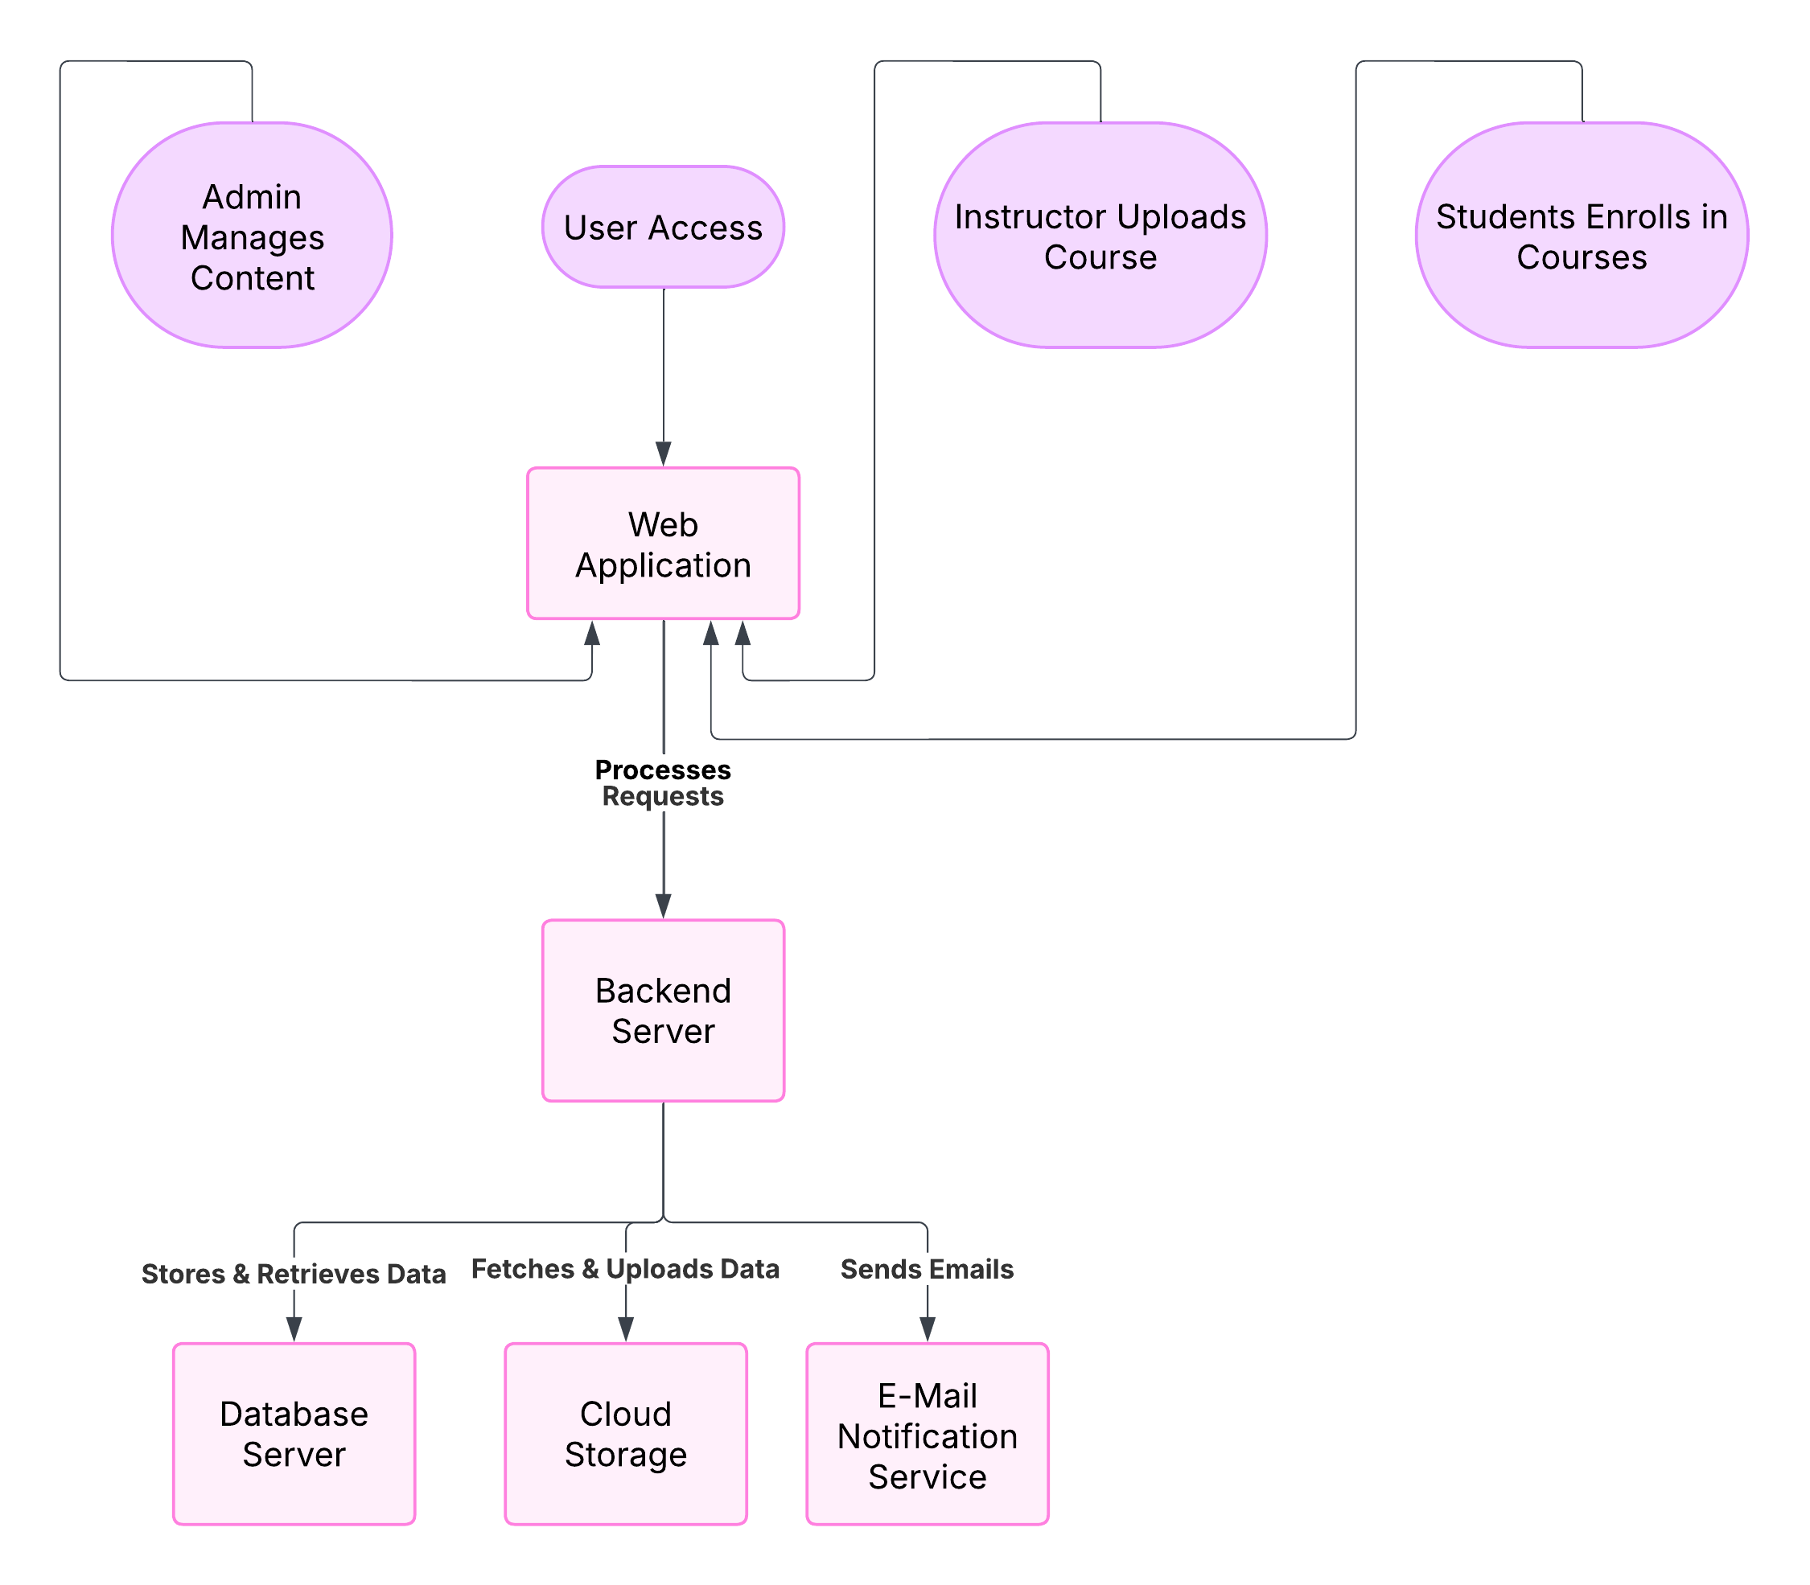
FLOW CHART

Slide 13
FEATURES
Provides role-based login for Students, Instructors, and Admins with encrypted password storage.
Allows uploading and managing Videos, PDFs, Notes, and Study Materials for easy access.
Enables quiz creation by instructors with automated grading and instant result generation.
Provides user management, course control, system settings, and monitoring features for administrators.
Displays real-time progress of courses, quizzes through an interactive interface.
Manages structured storage of all user, course, and quiz data ensuring fast retrieval and security.

Slide 14
CONCLUSION
The E-Learning System is designed to provide a user-friendly platform for managing educational content, quizzes, and user data efficiently.
It ensures secure user authentication, role-based access, and smooth database operations for both administrators and students.
The system offers easy course management, progress tracking, and online assessments to enhance the learning experience.
It bridges the gap between technology and education by making learning more interactive, accessible, and engaging.
This project serves as a scalable solution for modern educational needs, fostering a dynamic and inclusive learning environment.

Slide 15
THANK
YOU

